Slide 1
Meeting 16/02/2022
Streamline Tables

Slide 2
Meeting Agenda
Summarise last sprint
Goals from last sprint – 10 minutes
More Detail from each person
Demonstration – 5 minutes
Example Tables
Discussion – 5 minutes
Handover
Plan Next Sprint
Goals before final presentation – 23/03/2022 – 5 minuets
Summarise Meeting / Discussion – 10 minuets

Slide 3
Last Sprint
1/12/2021 – 19/01/2022
Goals
Set up PythonAnywhere server
Communication between server and user
Specify a PDF page to extract
Extension UI
Achieved
Set up PythonAnywhere server, however there is limited use
Set up clear ways for the user and the server to communicate using a webpage
Implemented a popup on pdfs to specify page
Made a webpage to provide all the information and interaction for the user

Slide 4
Examples
https://dom-pubs.onlinelibrary.wiley.com/doi/10.1111/dom.14590
https://dom-pubs.onlinelibrary.wiley.com/doi/10.1111/dom.12903
https://www.scienceopen.com/document/read?vid=886dfe3f-56e3-4207-b2c1-07874e1c71c3

Slide 5
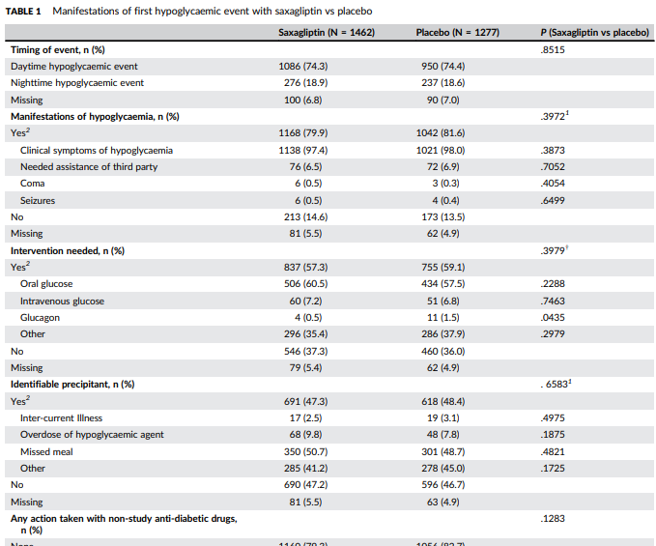
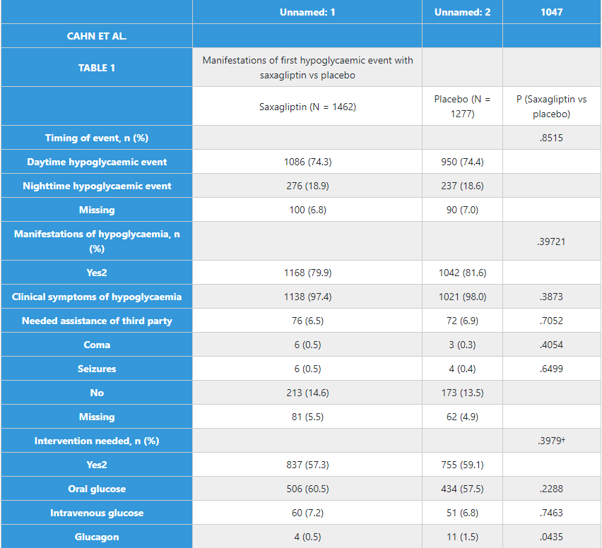
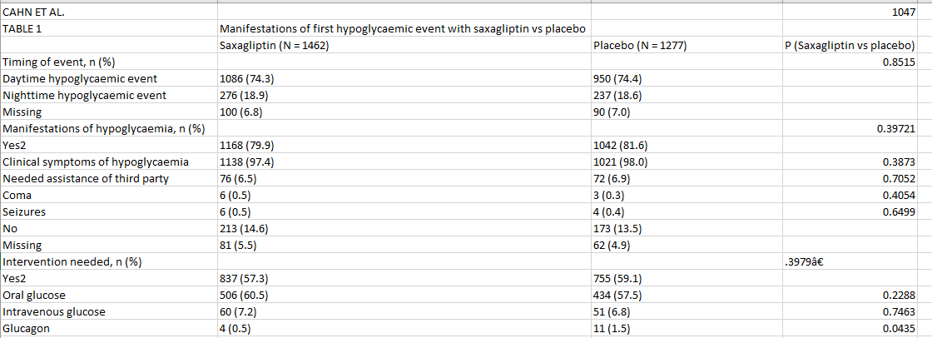
PDF - Some Unicode artifacts in the csv

Slide 6
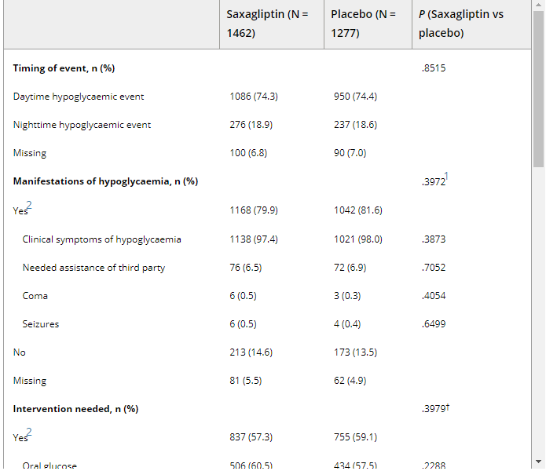
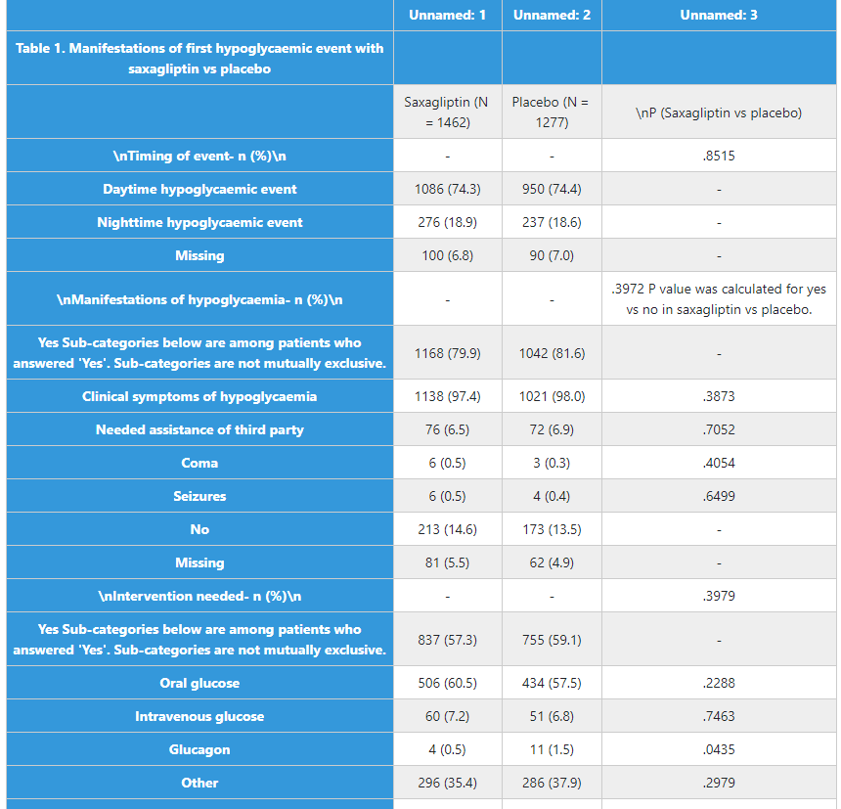
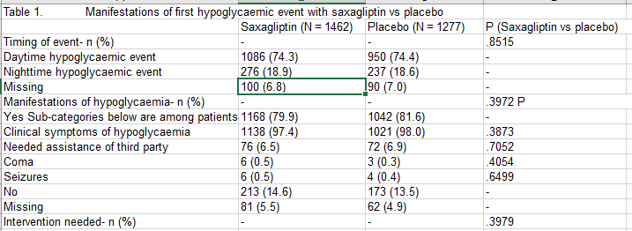
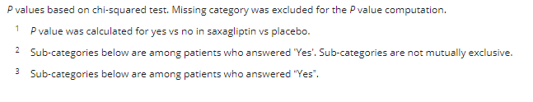
HTML - Some artifacts with “\n”
Includes Footnotes in table and at bottom

Slide 7
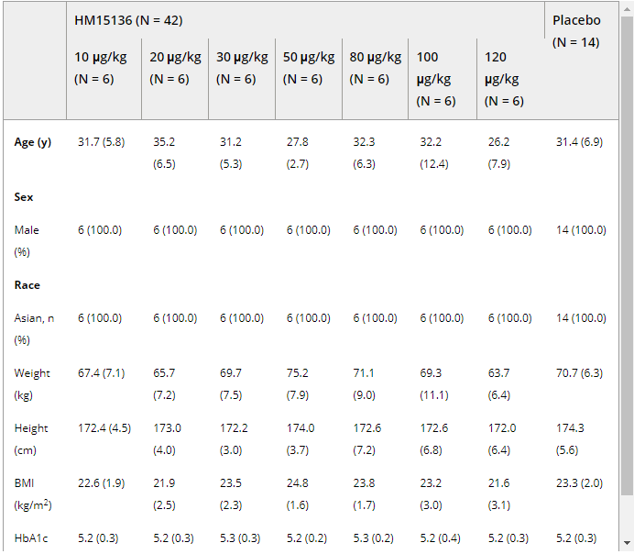
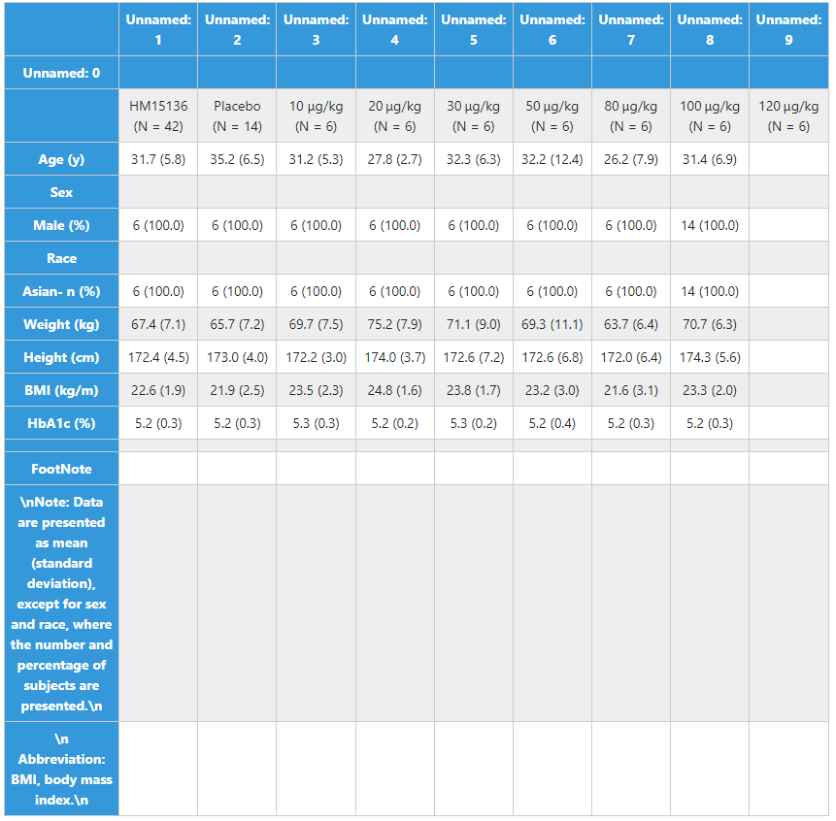
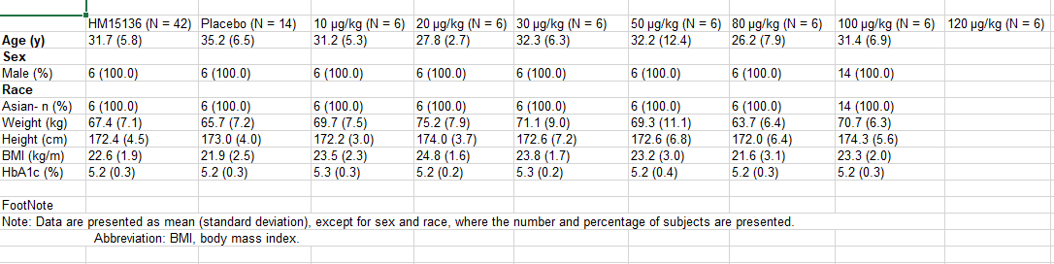
HTML - Some misalignment
of column titles

Slide 8
Final Sprint
16/02/2022 – 18/03/2022
Goals
Make the system resilient to errors
Finalise UI
Create Test Suite
Fix columns
Remove artifacts from text
Get server up and running

Slide 9
Summary
Summarise last sprint
Goals from last sprint – 10 minutes
More Detail from each person
Demonstration – 5 minutes
Example Tables
Discussion – 5 minutes
Handover
Plan Next Sprint
Goals before final presentation – 23/03/2022 – 5 minuets
Summarise Meeting / Discussion – 10 minuets

